Slide 1
ECE 313 MP3 Mid-Project Evaluation
Group 20: Yuchen Li, Harsh Modhera, Herman Pineda

Slide 2
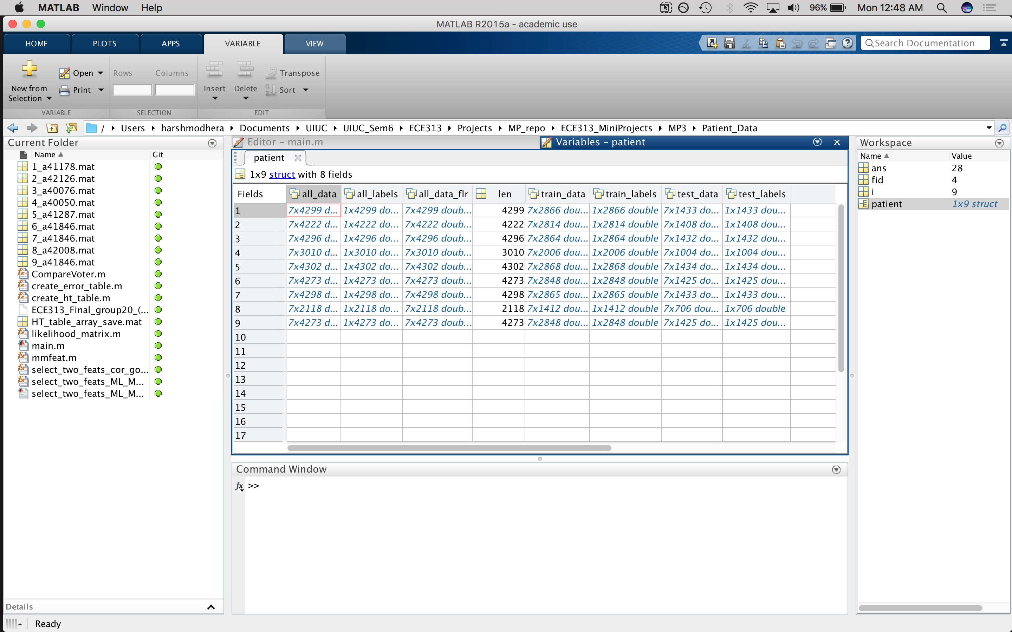
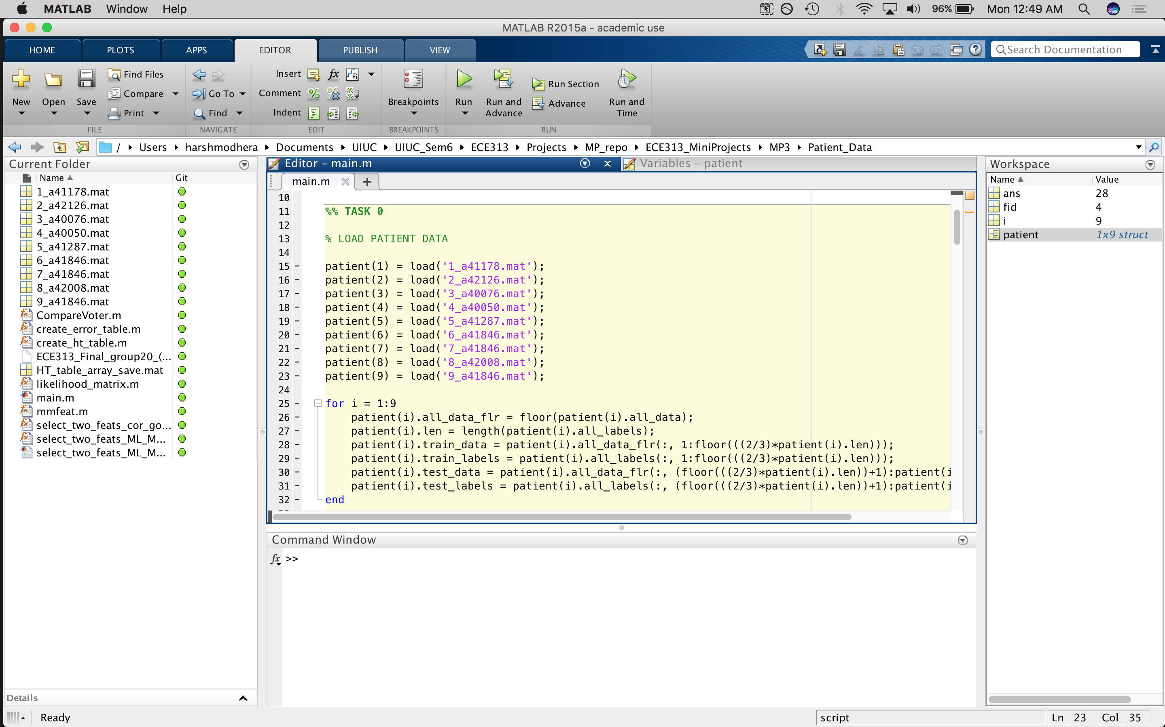
Task 0
Code: Patient Structure
Initial Patient Structure

Slide 3
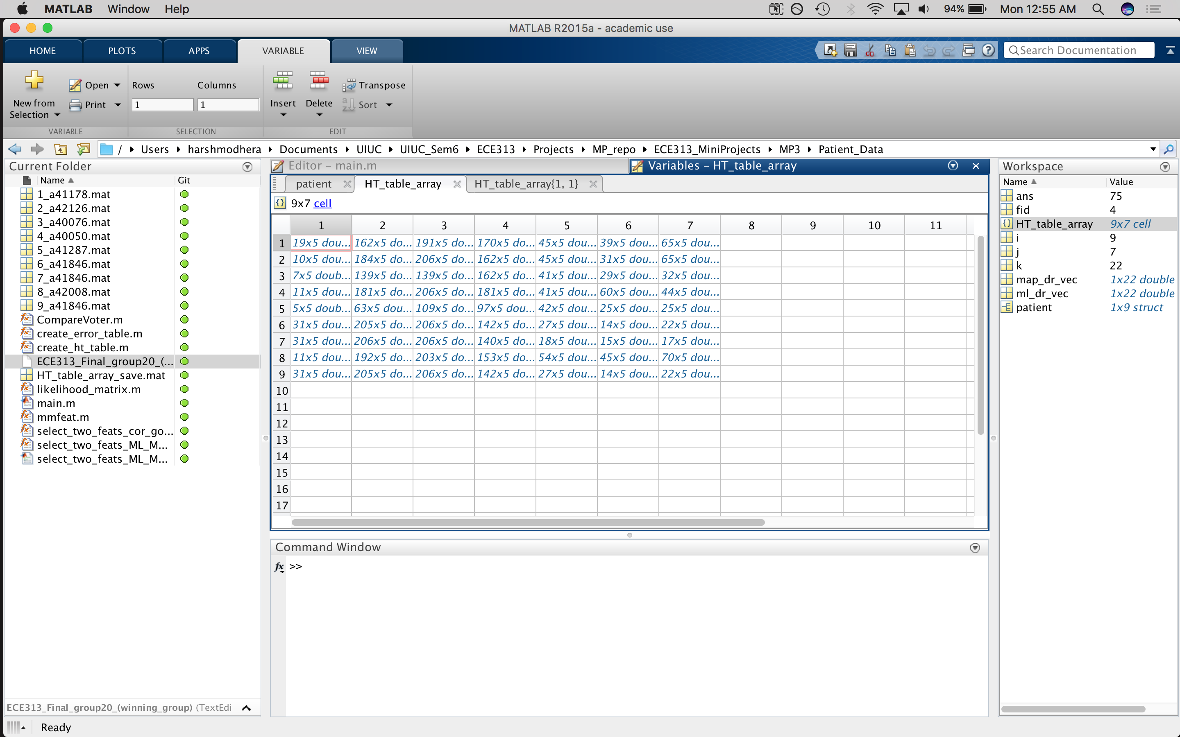
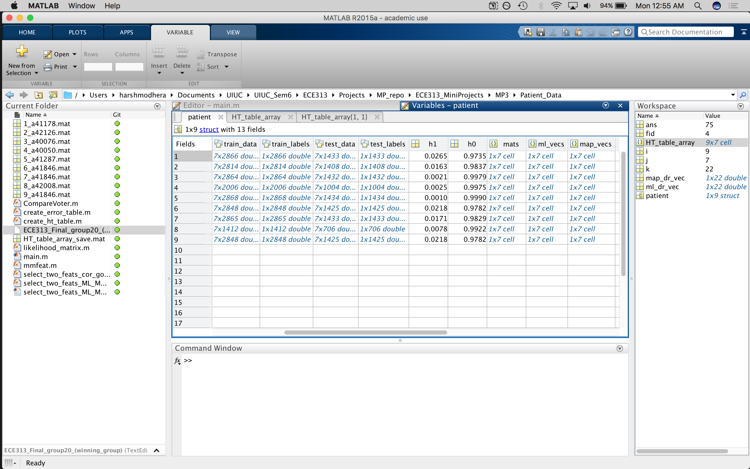
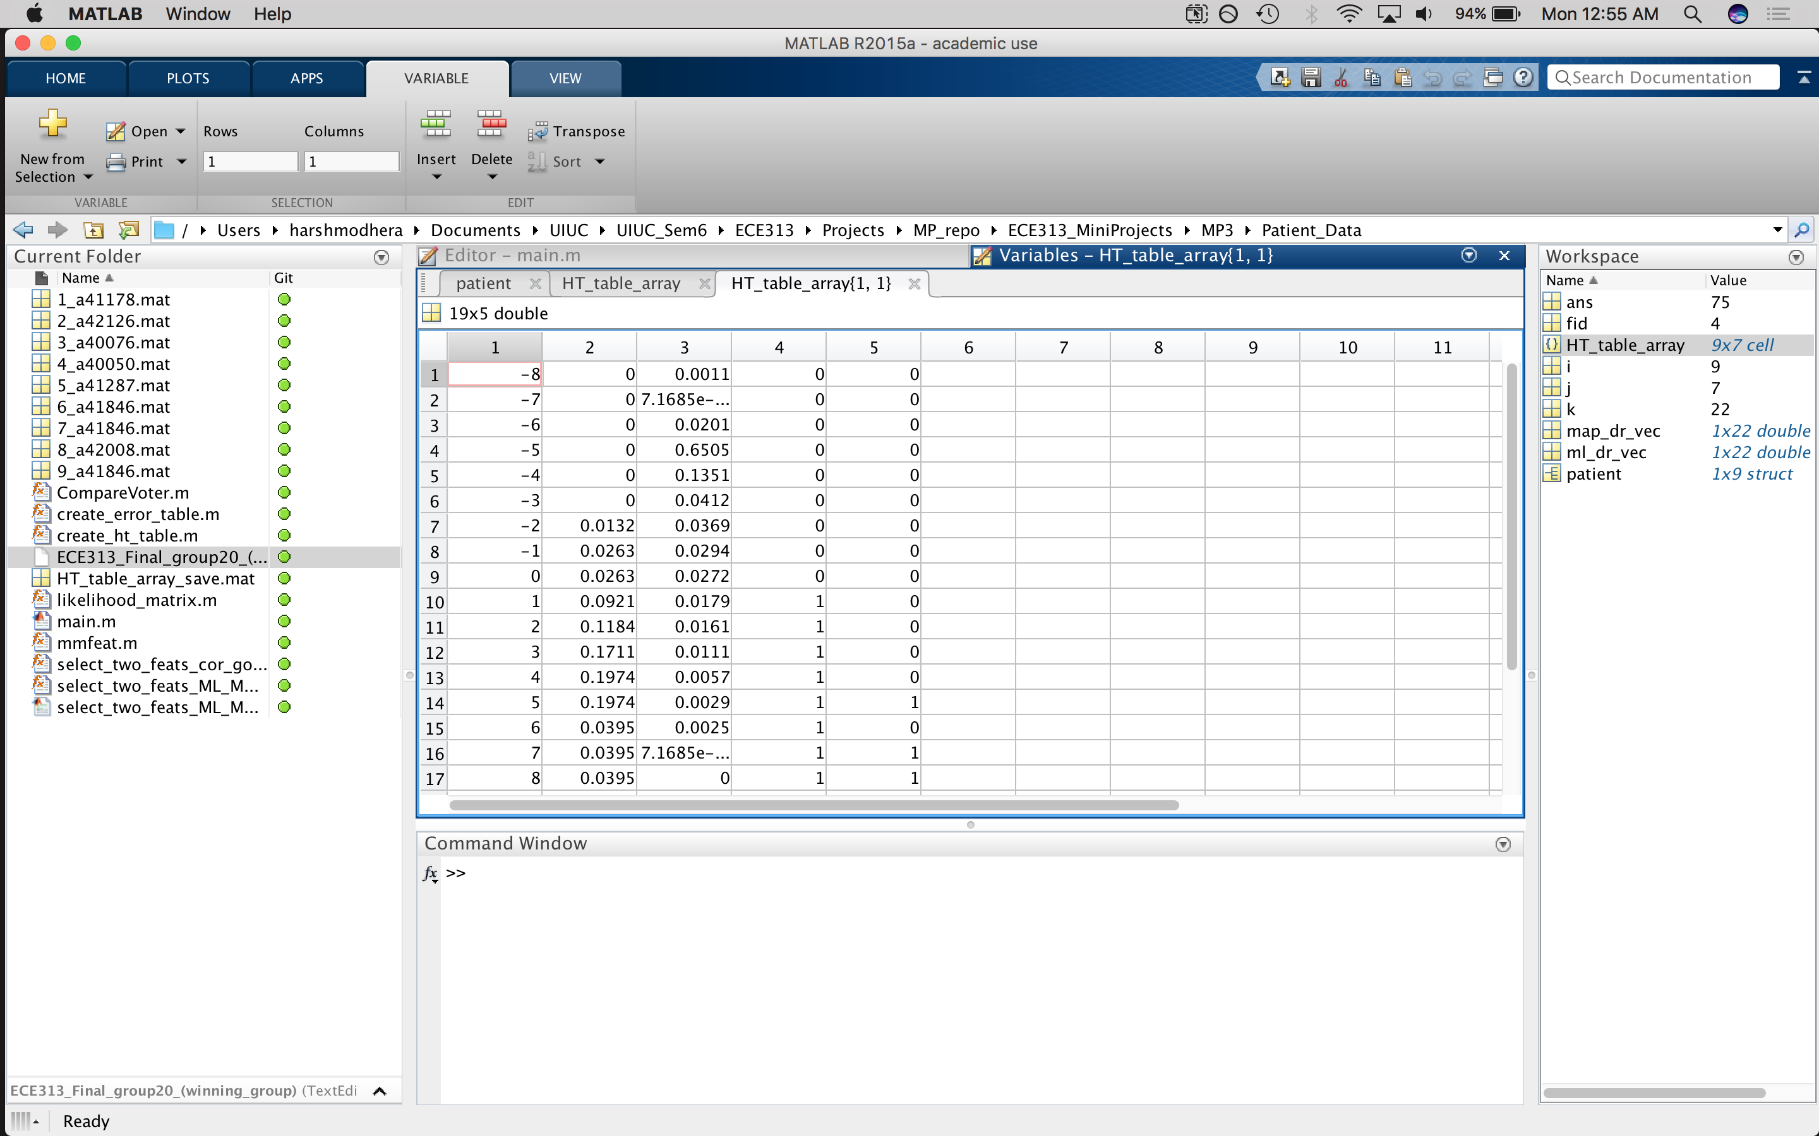
Task 1
HT Array
Updated Patient Structure
HT{1,1}

Slide 4
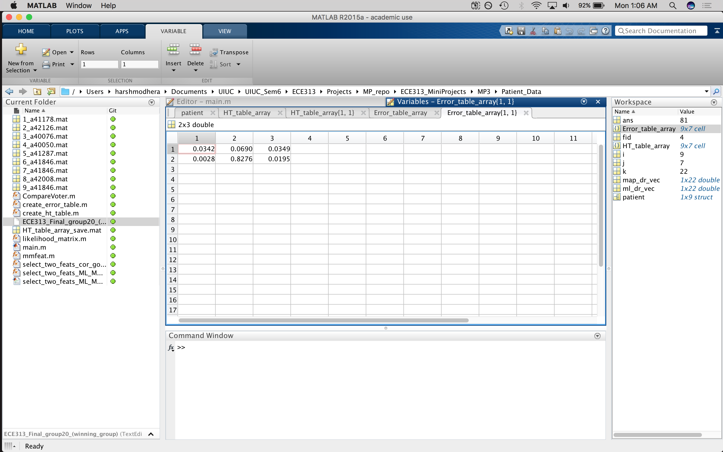
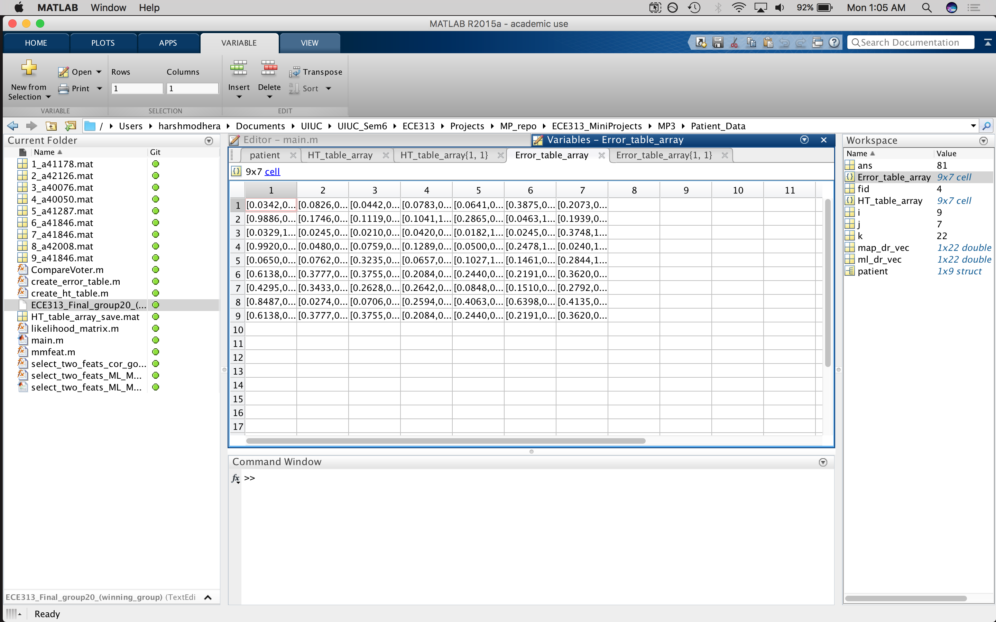
Task 1
ET Array
ET{1,1}

Slide 5
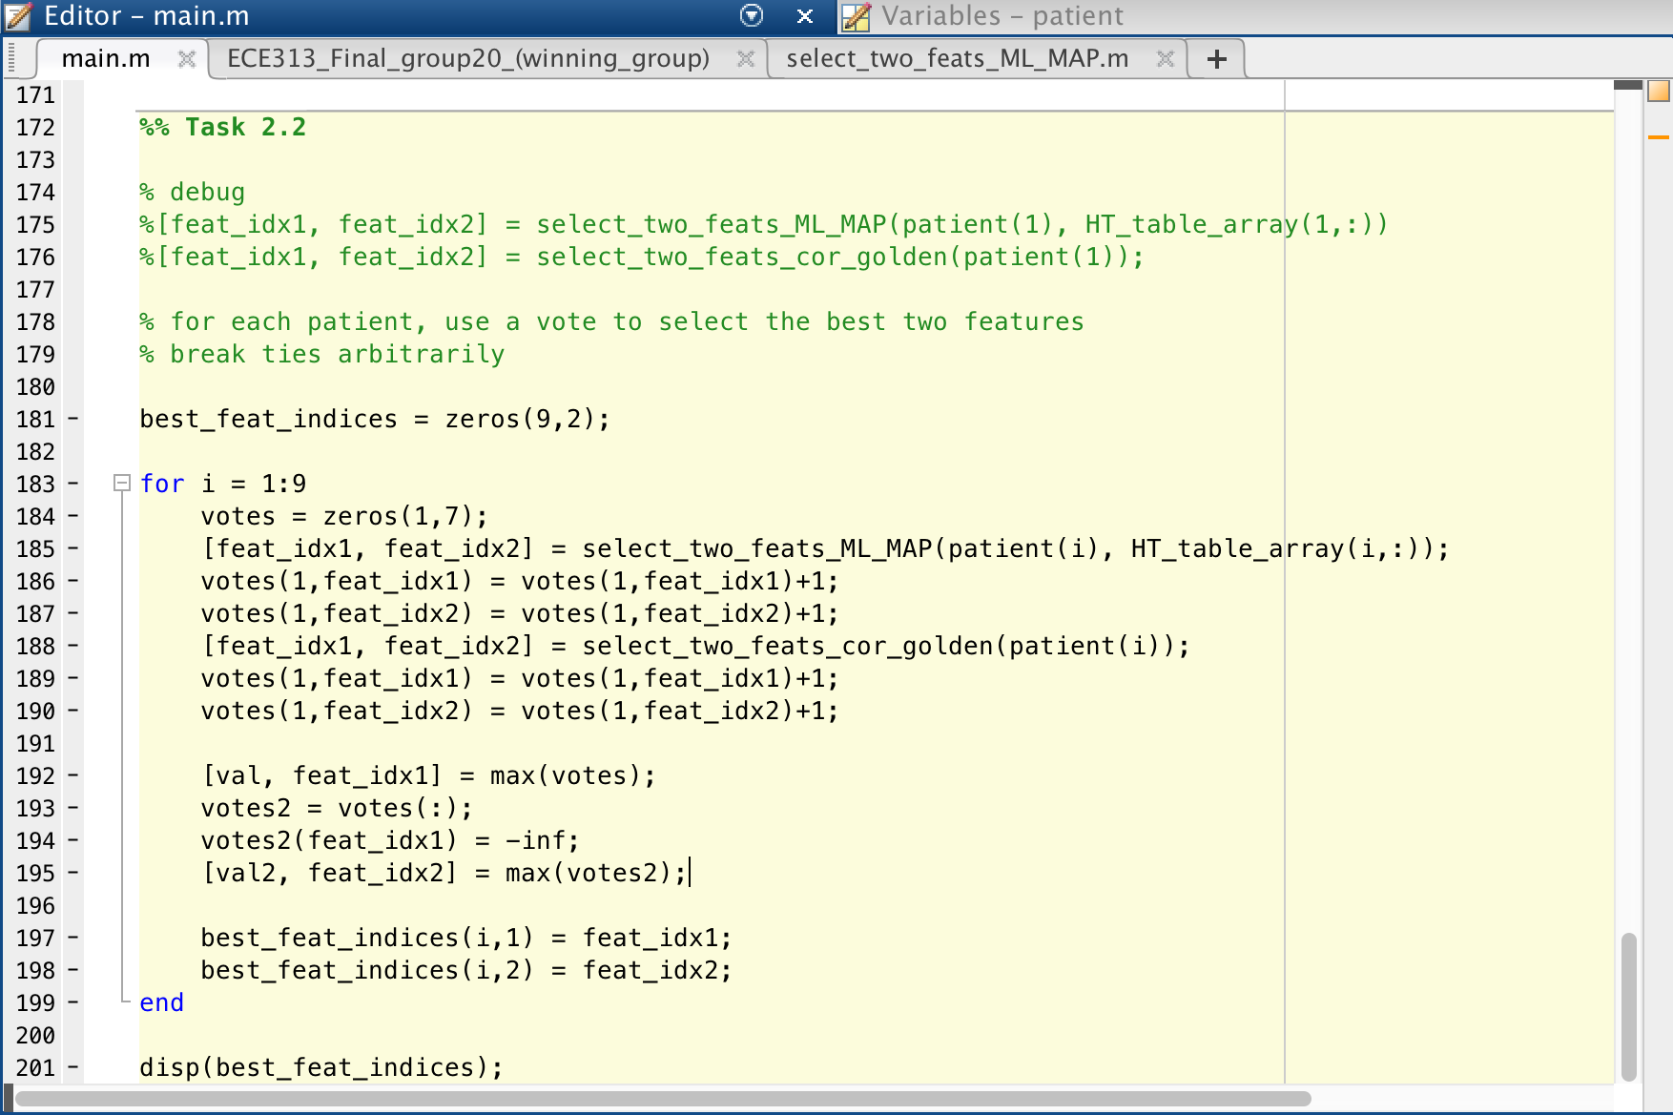
Task 2
Two metrics used:
- Lowest ML/MAP error
- Correlation with Golden Alarms
Results:
F1 F2
1 3
1 3
2 4
3 1
1 2
1 3
5 3
1 3
1 3

Slide 6
Group Evaluation/Work Distribution
First Meeting: May 16, 2017 (7pm-1:30am)
- All of us met up in Grainger basement
- Completed tasks 0-1.D
Second Meeting: May 20, 2017 (7pm-12am)
- All of us met up in Grainger basement
- Went through code and fixed bugs; Completed task 1.E
Third Meeting: May 22, 2017 (2pm-5pm)
- Yuchen and Herman met up in Grainger basement
- Attempted task 2.1 (there was an error); Completed task 2.2
- Harsh was sick so he did the report and PPT and code cleaning

